Slide 1
Cluster Analysis
Er. Avinash Navlani

Slide 2
“Where is the life, we have lost in living?
Where is the wisdom, we have lost in knowledge?
Where is the knowledge, we have lost in information?
(…) “Where is the information we have lost in data?”

Slide 3
Agenda
Cluster Analysis
Partitioning Methods
K-Mean
K Medoids
CLARA
CLARANS
Hierarchical
Agglomerative and Divisive, BIRCH
Density Based Methods: DBSCAN
Grid-based methods

Slide 4
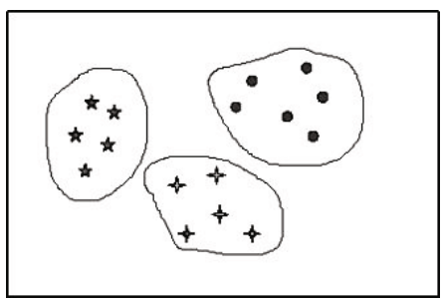
Clustering
Clustering means the method to divide a set of data into several groups (clusters), bunch of objects or clump based on certain similarities.
For Example:
Super-market different types of products are placed in separate departments e.g., cheese, meat products, appliances, etc.
People who gather together in groups (clusters) at a meeting based on common affinities, division of animals or plants into well defined groups like species, genus, etc..

Slide 5
Facts about Clustering
Clustering is also called data segmentation in some applications because clustering partitions large data sets into groups according to their similarity.
Clustering can also be used for outlier detection, where outliers (values that are “far away” from any cluster) may be more interesting than common cases.
Ex. Credit card fraud detection, monitoring of criminal activities
Classification is known as supervised learning because the class label information is given, that is, the learning algorithm is supervised in that it is told the class member-ship of each training tuple.
Clustering is known as unsupervised learning because the class label information is not present.
clustering is a form of learning by observation, rather than learning by examples.

Slide 6
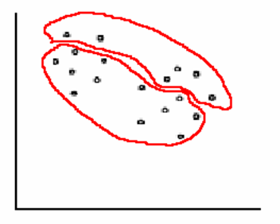
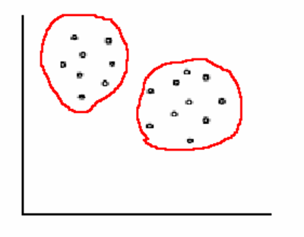
Principle of Cluster Analysis
World comprises set of objects, each of them characterized by a set of attributes, and having provided a measure of similarity, the question that arises is how to divide them into groups (clusters) such that:
Homogeneity: Objects belonging to a cluster are more similar to one another.
Separation: Objects in different clusters are less similar to one another.

Slide 7
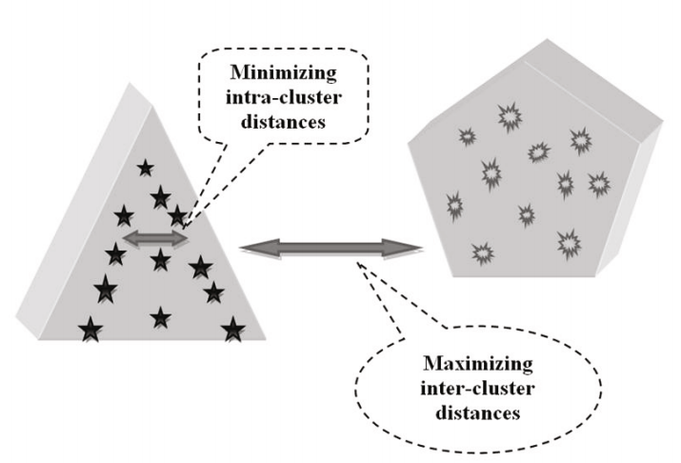

Slide 8
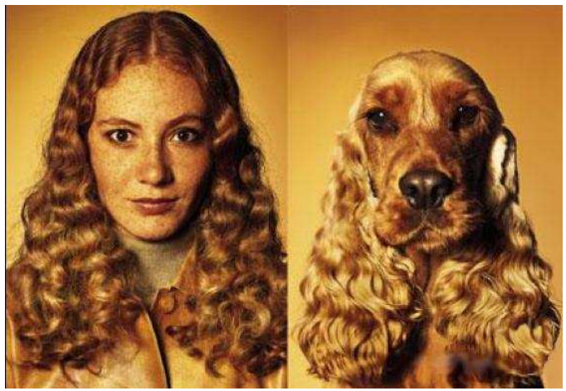
Similarity is Subjective
Similarity is often hard to define
Different similarity criteria can lead to different clusters.

Slide 9
Application
Market segmentation
Document clustering
Business Intelligence
Image pattern recognition
In Biology, the clustering process has important applications.
Grouping companies on the stock exchange.
Earth-quake studies
Insurance
Spatial Data Analysis
Economic Science

Slide 10
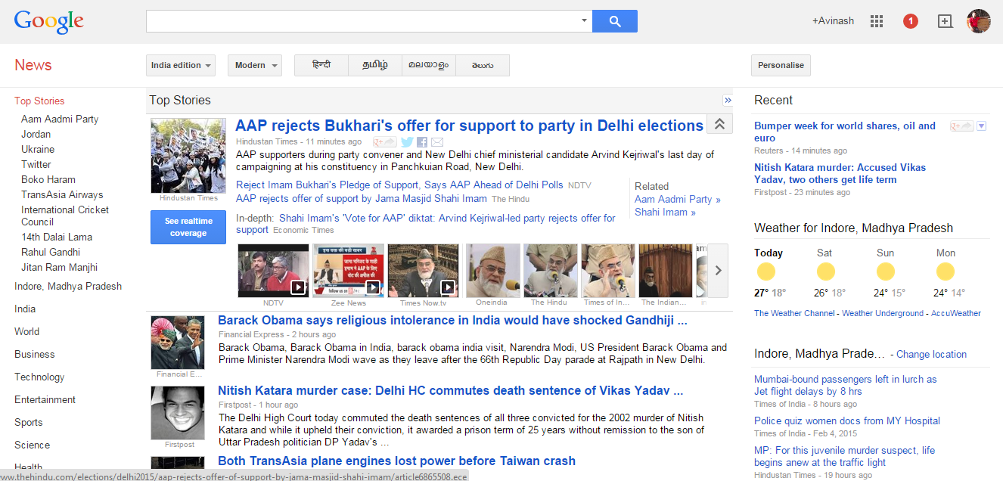
`

Slide 11
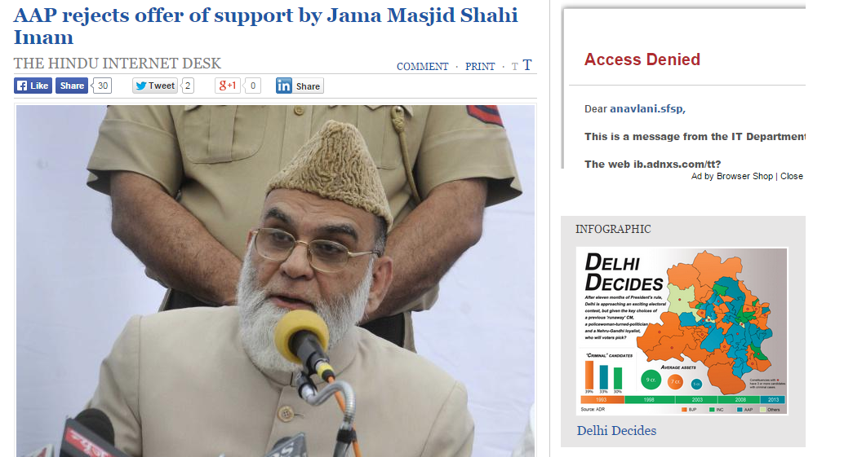

Slide 12
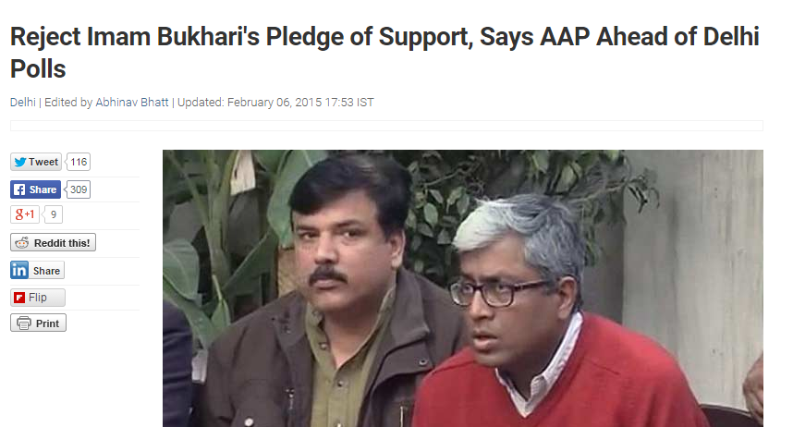

Slide 13
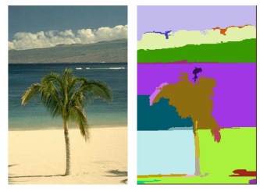
Image Segmentation

Slide 14
Classification Vs. Clustering
Classification
Clustering
known number of classes
unknown number of classes
based on a training set
no prior knowledge
used to classify future observations
used to understand (explore) data
Classification is a form of supervised learning
Clustering a form of unsupervised learning

Slide 15
Clustering Methods
General Clustering Methods
Partitioning Methods
Hierarchical
Density Based Methods
Grid-based methods
Advance Clustering Methods:
Probabilistic model-based clustering
Clustering graph and network data
Clustering high-dimensional data
Clustering with constraints

Slide 16
Clustering Techniques
Partitioning Methods
K-Mean
K Medoids
Hierarchical
Agglomerative and Divisive, BIRCH, ROCK
Density Based Methods: DBSCAN

Slide 17
Partitioning Method
Partitioning method constructs k partitions of the data, where each partition represents a cluster.
Partitioning Methods:
k-means
k-medoids algorithms.
CLARA
CLARANS
Distance-based
May use mean or medoid (etc.) to represent cluster center
Effective for small- to medium-size data sets
Heuristic clustering methods work well for finding spherical-shaped clusters in small- to medium-size databases.
Construct various partitions and then evaluate them by some criterion, e.g., minimizing the sum of square errors

Slide 18
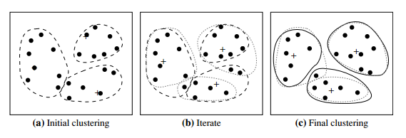

K-means
A Centroid-Based Technique uses the centroid of a cluster.
Given Data set D is divided into k partitions(cluster);
Sum of Squared Error
E= $\sum_{i=1}^{k}{\sum_{p∈Ci}{dist(p,Ci)}}$²

Slide 19
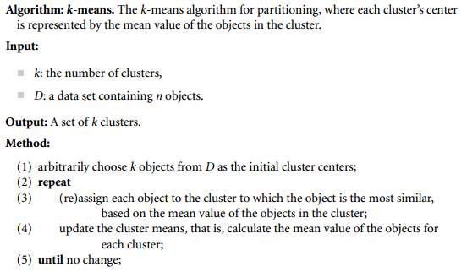
K-Mean Partitioning Method

Slide 20
K-Mean Partitioning Method
10
10
9
9
8
8
7
7
6
6
5
5
4
Assign each objects to most similar center
Update the cluster means
4
3
3
2
2
1
1
0
0
0
1
2
3
4
5
6
7
8
9
10
0
1
2
3
4
5
6
7
8
9
10
reassign
reassign
K=2
Arbitrarily choose K object as initial cluster center
Update the cluster means

Slide 21
K-Mean Partitioning Method
10
10
9
9
8
8
7
7
6
6
5
5
4
Assign each objects to most similar center
Update the cluster means
4
3
3
2
2
1
1
0
0
0
1
2
3
4
5
6
7
8
9
10
0
1
2
3
4
5
6
7
8
9
10
reassign
reassign
K=2
Arbitrarily choose K object as initial cluster center
Update the cluster means

Slide 22
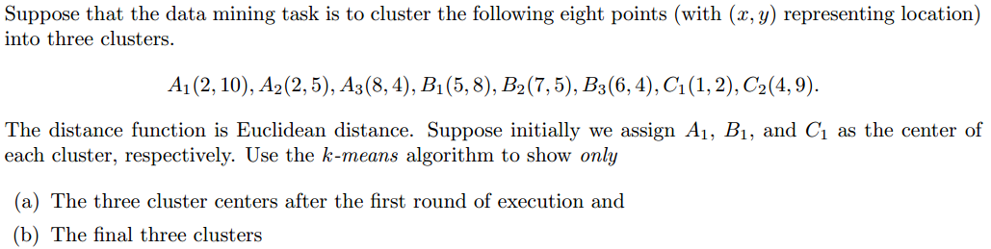
Exercise

Slide 23
Issues with k-means Algorithm
k-means method is not guaranteed to converge to the global optimum and often terminates at a local optimum.
The results may depend on the initial random selection of cluster centers.
the number of clusters, in advance can be seen as a disadvantage.
The k-means method is not suitable for discovering clusters with non-convex shapes or clusters of very different size.
Not suitable for nominal attributes.
k-modes method is a variant of k-means, can be use with nominal attributes.
It is sensitive to noise and outlier data points.
Solution: Instead of taking the mean value of the objects in a cluster as a reference point, we can pick actual objects to represent the clusters, using one representative object per cluster.

Slide 24
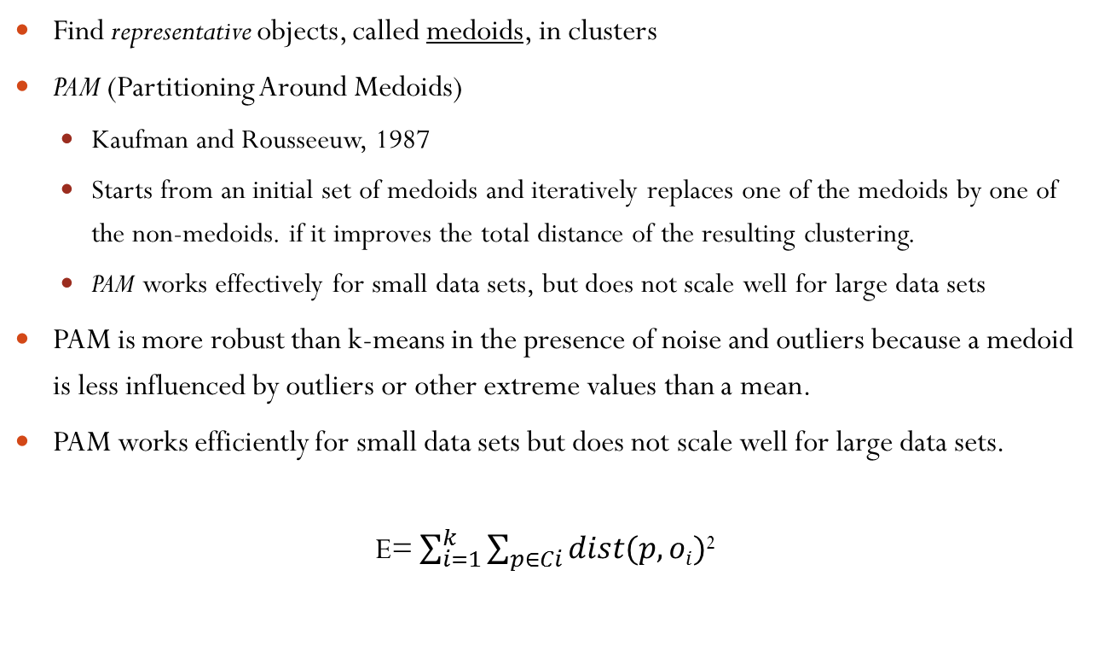
K-medoids
Find representative objects, called medoids, in clusters
PAM (Partitioning Around Medoids)
Kaufman and Rousseeuw, 1987
Starts from an initial set of medoids and iteratively replaces one of the medoids by one of the non-medoids. if it improves the total distance of the resulting clustering.
PAM works effectively for small data sets, but does not scale well for large data sets
PAM is more robust than k-means in the presence of noise and outliers because a medoid is less influenced by outliers or other extreme values than a mean.
PAM works efficiently for small data sets but does not scale well for large data sets.
E= $\sum_{i=1}^{k}{\sum_{p∈Ci}{dist(p,oi)}}$²

Slide 25
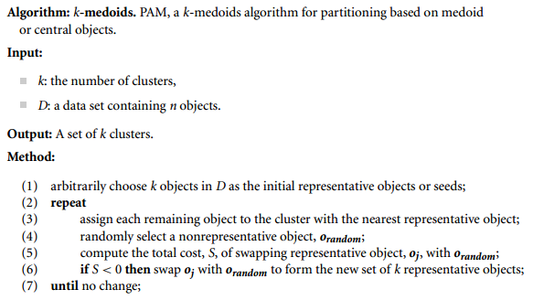
K-medoid Algorithm

Slide 26
CLARA: Cluster LARge Application
Sampling based method
It select sample of data set then apply PAM.
Benefits:
It can deal with large data set.
Effectiveness depends upon sample size
Issue:
CLARA can’t find best clustering without best medoid sample.
PAM finds the best k medoids among a given data, and CLARA finds the best k medoids among the selected samples.

Slide 27
CLARANS: Clustering LARge Application based upon RANdom Search
Improve Quality of CLARA
Quality depends upon random sampling method
It draws a sample with some randomness in each step of the search
Still the clustering quality depends on the sampling method

Slide 28
Summary
Partitioning methods find sphere-shaped clusters
K- means sensitive to outliers
PAM uses medoids of the clusters instead of means
CLARA and CLARANS are used for clustering large databases

Slide 29
Hierarchical Methods
Hierarchical method partition data into groups at different levels such as in a hierarchy.
Observation vectors (cases) are group together on the basis of their mutual distance.
The hierarchical clustering model lies in iteratively grouping objects using a particular method of ”amalgamation/linkage”. such as:
Single linkage
Complete linkage
Average linkage
Centroid method

Slide 30
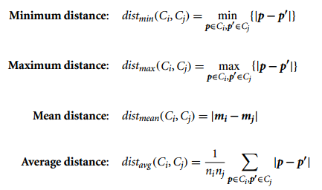
Distance Measures in Algorithmic Methods
Single linkage based on minimum distance, or the nearest neighbor rule.
Complete linkage based on the maximum distance or the furthest neighbor approach.
Average linkage distance between two clusters is defined as the average of the distances between all pairs of objects.
Centroid method distance between two clusters is the distance between their centroids

Slide 31
Hierarchical Clustering
Algorithmic methods
Agglomerative
Divisive
Multiphase Method
BIRCH
Chameleon
Probabilistic methods
Bayesian methods.

Slide 32
Agglomerative Method
It uses a bottom-up strategy.
Agglomerative methods start with individual objects as clusters, which are iteratively merged to form larger clusters.
It starts with leafs and merge two clusters that are closest to each other according to some similarity measure and form one cluster.
Also known as AGNES (AGglomerative NESting).

Slide 33
Divisive Methods
It uses top-down strategy.
Divisive methods initially let all the given objects form one cluster, which they iteratively split into smaller clusters.
It starts by placing all objects in one cluster, which is the hierarchy’s root. then divides the root cluster into several smaller sub-clusters, and recursively partitions those clusters into smaller ones.
The partitioning process continues until each cluster are sufficiently similar to each other.
Also known as DIANA (DIvisive ANAlysis).

Slide 34
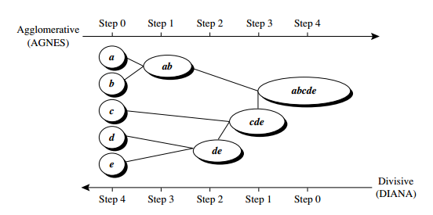
Agglomerative versus divisive hierarchical clustering

Slide 35
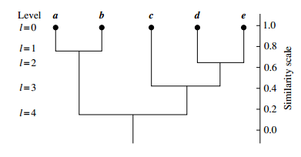
Dendrogram
A tree structure called a dendrogram is commonly used to represent or visualize the process of hierarchical clustering.
It is nested set of partitions, where data represented by tree.

Slide 36
Issues with Divisive Methods
There are 2^{n-1}-1possible ways to partition a set of n objects into two exclusive subsets, where n is the number of objects.
Computationally it is not easy to examine all possibilities.
Divisive methods typically do not backtrack on partitioning decisions that have been made.

Slide 37
Multiphase Hierarchical Clustering
Hierarchical clustering methods can encounter difficulties regarding the selection of merge or split points. if not well chosen, may lead to low-quality clusters.
A promising direction for improving the clustering quality of hierarchical methods is to integrate hierarchical clustering with other clustering techniques, resulting in multiple-phase (or multiphase) clustering.
BIRCH
Chameleon

Slide 38
BIRCH
Balanced Iterative Reducing and Clustering using Hierarchies (BIRCH) is designed for clustering a large amount of numeric data by integrating hierarchical clustering and other clustering methods such as iterative partitioning.
It overcomes the two difficulties in agglomerative clustering methods:
Scalability
The inability to undo what was done in the previous step.
It uses the notions of clustering feature to summarize a cluster, and clustering feature tree (CF-tree) to represent a cluster hierarchy.

Slide 39
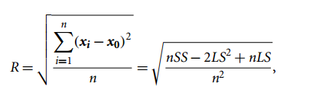

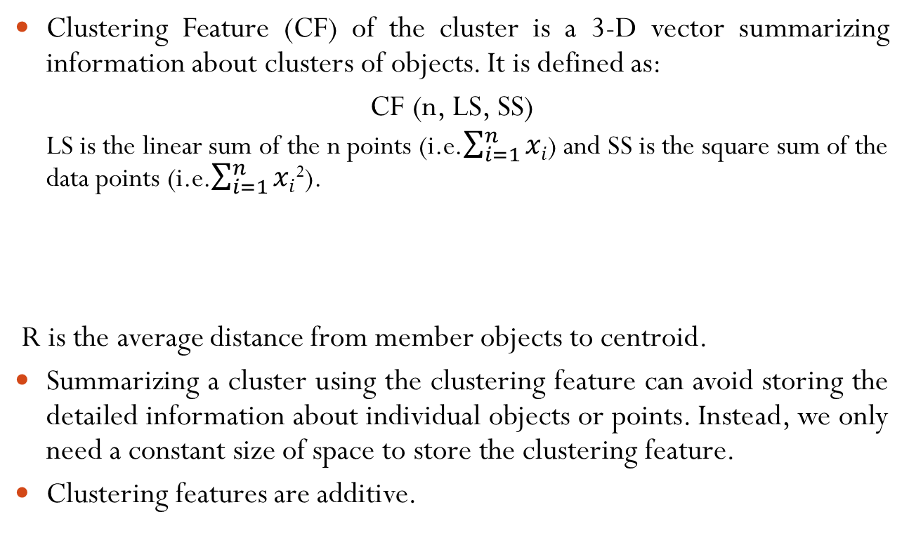
Clustering Feature
Clustering Feature (CF) of the cluster is a 3-D vector summarizing information about clusters of objects. It is defined as:
CF (n, LS, SS)
LS is the linear sum of the n points (i.e.$\sum_{i=1}^{n}{xi}$) and SS is the square sum of the data points (i.e.$\sum_{i=1}^{n}{xi}$²).
R is the average distance from member objects to centroid.
Summarizing a cluster using the clustering feature can avoid storing the detailed information about individual objects or points. Instead, we only need a constant size of space to store the clustering feature.
Clustering features are additive.

Slide 40
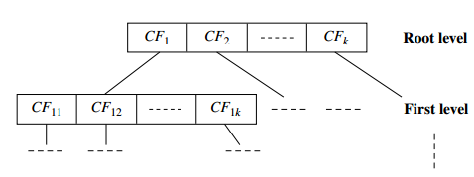
Cluster Feature Tree
A CF-tree is a height-balanced tree that stores the clustering features for a hierarchical clustering.
A CF-tree has two parameters: branching factor, B, and threshold, T .
The branching factor specifies the maximum number of children per non leaf node.
The threshold parameter specifies the maximum diameter of sub clusters stored at the leaf nodes of the tree.

Slide 41
BIRCH
Two Phases:
Phase 1: BIRCH scans the database to build an initial in-memory CF-tree, which can be viewed as a multilevel compression of the data that tries to preserve the data’s inherent clustering structure.
Phase 2: BIRCH applies a (selected) clustering algorithm to cluster the leaf nodes of the CF-tree, which removes sparse clusters as outliers and groups dense clusters into larger ones.

Slide 42
How effective is BIRCH?
The time complexity of the algorithm is O(n), where n is the number of objects to be clustered.

Slide 43
Limitations
BIRCH uses Euclidean distance and inter-cluster proximity, which leads to spherical shaped clusters.
If the clusters are not spherical in shape, BIRCH does not perform well
CF tree can hold only a limited number of entries due to its size.

Slide 44
K-means Vs. Hierarchical Clustering
There is no hierarchy, the data are partitioned.
There is no role for the dendrogram in k-means clustering.
You must supply the number of clusters (k) into which the data are to be grouped.

Slide 45
Density Based Clustering Method
Based on notion of density.
Partitioning and hierarchical methods are designed to find spherical-shaped clusters.
Clusters may have shape such as the “S” shape and oval clusters.
we can model such clusters as dense regions in the data space, separated by sparse regions.
The main idea is to continue growing a given cluster as long as the density in its \neighborhood" exceeds some threshold.
Density Based Clustering Method:
DBSCAN
OPTICS
DENCLUE

Slide 46
DBSCAN
DBSCAN stands for Density-Based Spatial Clustering of Applications with Noise.
How can we find dense regions in density-based clustering?
The density of an object O can be measured by the number of objects close to object O. It finds core objects, that is, objects that have dense neighborhoods. It connects core objects and their neighborhoods to form dense regions as clusters.
How does DBSCAN quantify the neighborhood of an object?
Neighborhood size parameterized by €, the density of a neighborhood can be measured simply by the number of objects in the neighborhood.
To deter-mine whether a neighborhood is dense or not,
DBSCAN uses another user-specified parameter, MinPts, which specifies the density threshold of dense regions.

Slide 47
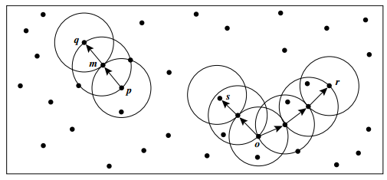
DBSCAN (Conti…)
How can we assemble a large dense region using small dense regions centered by core objects?
In DBSCAN, p is density-reachable from q.

Slide 48
DBSCAN (Conti…)
Advantages:
Does not require prior specification of number of clusters.
Able to identify noise data while clustering.
Able to find out arbitrary size and arbitrary shaped clusters.
Disadvantages
Fails in case of varying density cluster.
Does not work well in high dimensional data.

Slide 49
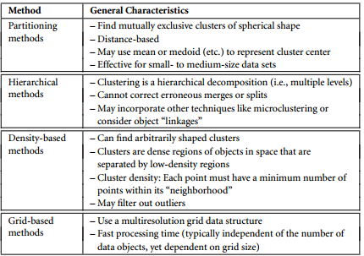
Overview of Clustering Methods

Slide 50
Assignment
Determining number of Cluster in K-Means Clustering
Elbow method
Information Criterion Approach
An Information Theoretic Approach
Choosing k Using the Silhouette Coeffiecient
Cross validation

Slide 51
Expert Comments
I would always start with K-Means. Not only is it the simplest clustering algorithm, it also performs quite well on a variety of datasets.
There's no free lunch. Every approach has strengths and weaknesses. Try k-means first. If it doesn't work, try agglomerative clustering - tweak its myriad configurations. If that doesn't work but you can think of a clever way to represent your dataset as a graph, deploy spectral clustering. Try to use an autoencoder to retrieve a better representation you can use for clustering.

Slide 52


Slide 53
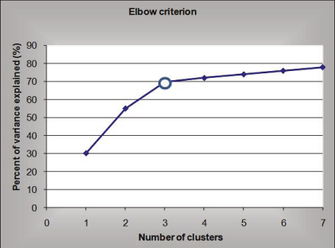
Elbow Criteria (Conti…)

Slide 54
Elbow Criterion
Let us mention a very important issue in the clustering process - the science to choose the optimal number of clusters (groups) of objects.
It says that we should choose a number of clusters so that adding another cluster does not add sufficient information to continue the process.
The percentage of variance explained is the ratio of the between-group variance to the total variance.

Slide 55
If you graph the percentage of variance explained by the clusters against the number of clusters, the first clusters will add much information (explain a lot of variance), but at some point the marginal gain will drop, giving an angle in the graph. The number of clusters are chosen at this point, hence the “elbow criterion”.

Slide 56
Measures of similarity
Minkowski distance
Tanimoto measure;
Pearson’s rmeasure;
Mahalanobis measure.

Slide 57
medicine | weight | ph
a | 1 | 1
b | 2 | 1
c | 4 | 3
d | 5 | 4

